Slide 1
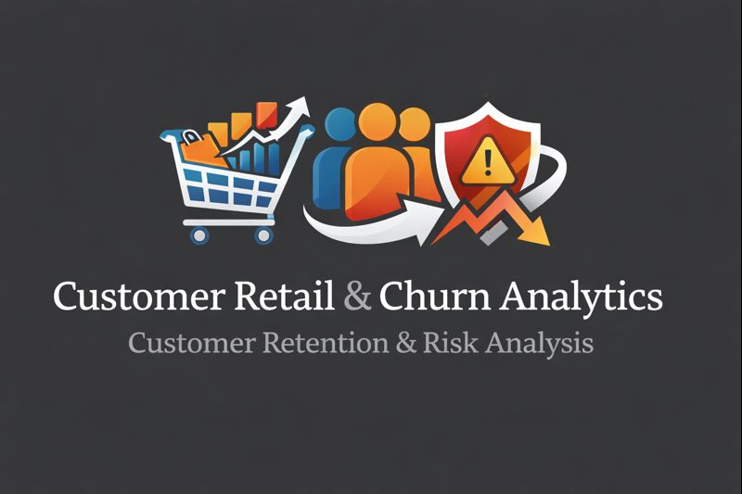
Customer Analytics & Churn Risk Analysis
An End-to-End Business Analytics Case Study
Tools: Excel | SQL | Python | Power BI
Tanish Sable
Business Analyst Project

Slide 2
BUSINESS CONTEXT
What was the business problem?
The company operates in a retail and e-commerce environment with: Large customer base High transaction volume
No clear visibility into: Customer value Churn risk Revenue concentration
Why this problem matters?
Losing high-value customers significantly affects revenue.
Marketing expenses are ineffective without segmentation. Leadership does not have actionable insights.

Slide 3
PROJECT OBJECTIVES
we aimed to achieve Understanding customer purchasing behavior.
Segmenting customers using data-based logic.
Identifying high-risk and high-value churn customers.
Building a decision-ready dashboard for stakeholders.

Slide 4
DATA OVERVIEW
Dataset Description
Source: Online retail transaction data
Records: 1M+ transactions
Time period: Multi-year transactional data
Key Fields
Invoice, CustomerID
Quantity, Price
Invoice Date
Country
Revenue

Slide 5
DATA PREPARATION USING EXCEL
Before starting any analysis, our top priority was to make the data reliable and understandable.
The raw dataset came directly from transactional systems.
It was large, messy, and not ready for analysis.
What we did in Excel We used Excel as our first step to:
Review the raw structure of the data and Understand each column from a business perspective
Identify obvious quality issues early Key preparation steps included
Converting date-time fields into usable formats - Breaking down invoice timestamps into date, year, and month
Creating a revenue column by multiplying quantity and price - Checking for missing customer IDs and unusual values
Classifying transactions into meaningful types (sales vs non-sales)

Slide 6
OUTPUTS & KEY LEARNINGS
The Excel phase produced: A cleaned dataset with consistent data types.
Time-based features: Invoice Date. Year. Month.
A validated Revenue field at the transaction level.
Clear identification of valid customer records.
A dataset arranged for easy import into SQL and Python.
Even at this early stage, a few patterns became clear.
A small group of customers appeared frequently on invoices.
Revenue was spread unevenly among customers.
Some periods showed higher transaction volumes, indicating seasonality.

Slide 7
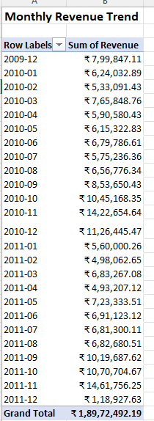
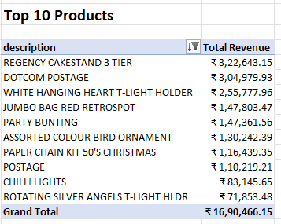
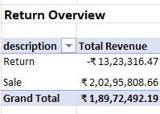
Excel Insights

Slide 8
DATA VALIDATION & METRIC CHECKS USING SQL
Once we prepared the data in Excel, the next step was to check the numbers in a more organized and dependable environment.
So, we transferred the dataset into MySQL.
What we did in SQL In SQL, we concentrated on validating important business metrics instead of doing exploratory analysis.
The main activities included: Loading the cleaned dataset into a relational database.
Rechecking revenue calculations on a large scale.
Filtering transactions to include only valid sales.
Aggregating data to calculate: Total revenue. Total number of orders. Customer-level revenue. Time-based summaries.

Slide 9
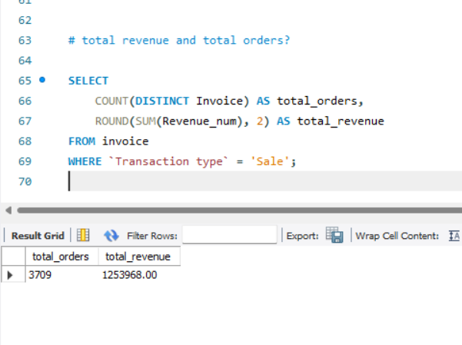
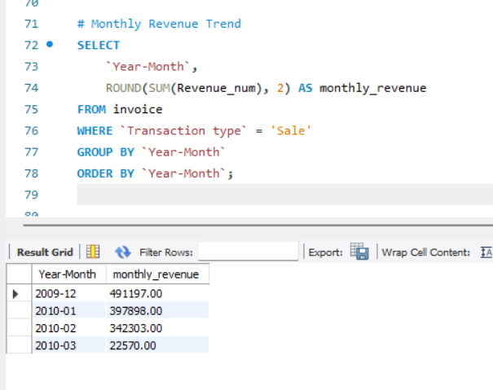
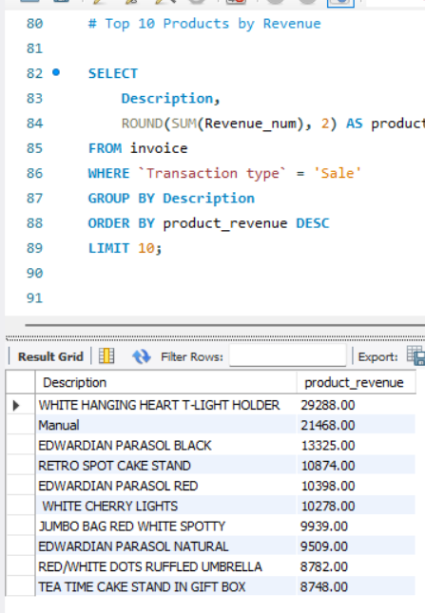
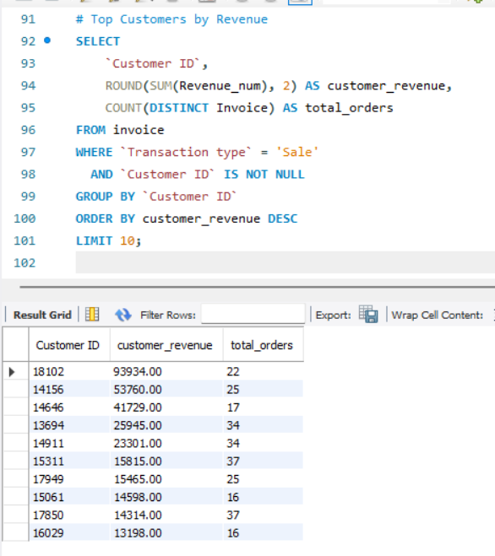
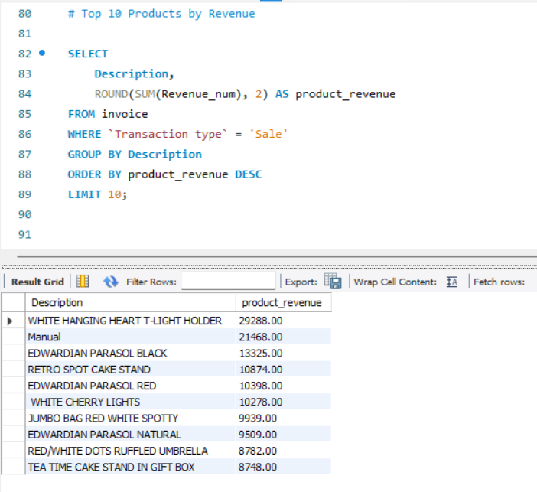

Slide 10
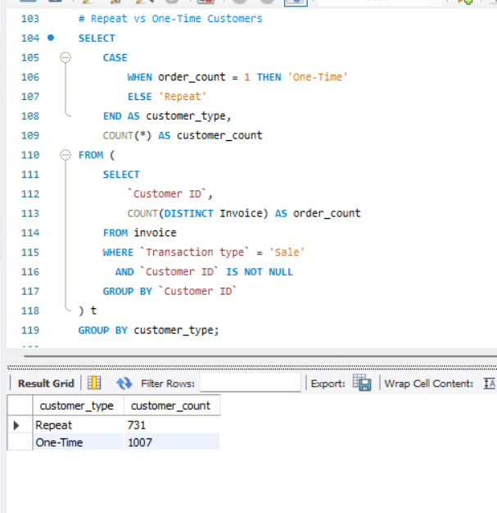
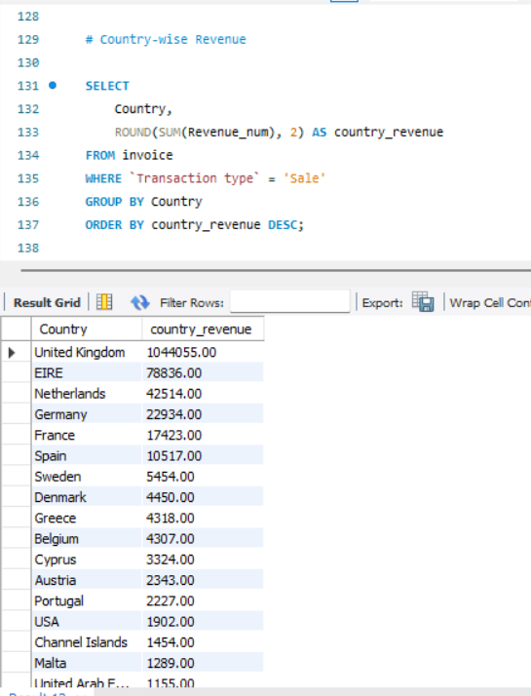
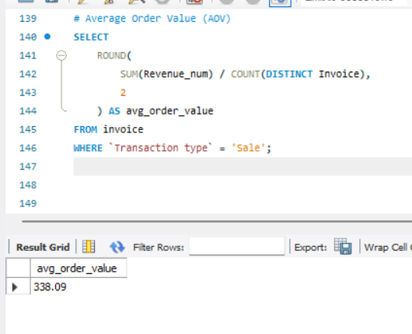

Slide 11
OUTPUTS & BUSINESS CONFIRMATION
After running several validation queries, we gained a strong confidence in the data accuracy.
SQL helped us confirm: Revenue totals matched Excel calculations. Customer counts were consistent across time periods.
No duplicate or invalid transactions were inflating metrics.
Time-based aggregations behaved as expected.

Slide 12
ADVANCED CUSTOMER ANALYTICS USING PYTHON
After validating the data using Excel and SQL, the next challenge was no longer about data correctness, but about understanding the business.
At this stage, we needed to answer deeper questions:
Which customers are truly valuable?
How do customer behaviors differ?
Who is likely to churn soon?
These questions require behavioral analysis and scalable logic. This is where Python becomes essential.

Slide 13
RFM ANALYSIS: UNDERSTANDING CUSTOMER BEHAVIOR
To segment customers based on their actual purchasing behavior, we used RFM analysis, a common method in the industry.
What RFM measures are:
Recency, how recently a customer made a purchase.
Frequency, how often a customer purchases.
Monetary, how much revenue a customer generates.
Why we used RFM: It is based on data and is objective. It is easy to explain to business stakeholders.
It works well for segmentation and targeting.
Using Python, we calculated RFM values for each customer, ensuring accuracy and scalability.

Slide 14
RFM SCORING & CUSTOMER SEGMENTS
Once we calculated Recency, Frequency, and Monetary values, we converted them into relative scores using quartile-based logic.
How scoring worked: Customers were ranked compared to others. Higher scores indicated better engagement or value.
We combined individual R, F, and M scores into a single RFM score.
Customer segments created:
Champions – Recent, frequent, high-value customers.
Loyal – Consistent and valuable customers.
At Risk – Customers showing signs of disengagement.
Lost – Inactive, low-value customers.

Slide 15
CUSTOMER LIFETIME VALUE (CLV) ESTIMATION
While RFM explains behaviour, it does not directly show long-term value.
To tackle this, we estimated Customer Lifetime Value (CLV) using a practical, clear approach.
How we estimated CLV: - Average order value per customer - Purchase frequency over the observed period - Combined to estimate customer value potential
Why this mattered: - Not all frequent customers are high value - Some low-frequency customers generate significant revenue
CLV highlights customers worth keeping at a higher cost CLV provided a financial view to behavioural segmentation.

Slide 16
CHURN RISK IDENTIFICATION
To make the analysis forward-looking, we introduced a churn risk indicator.
How we defined churn risk: Customers with long periods of inactivity were flagged. We used recency thresholds to identify disengagement risk.
Why churn analysis was important: It's cheaper to keep existing customers than to acquire new ones.
High-value churn greatly affects revenue.
Identifying risk early allows for proactive retention strategies.
This step moved the project from descriptive analytics to risk-focused decision support.

Slide 17
OUTPUTS & BUSINESS IMPACT
Python produced:
Customer-level behavioural metrics
Clear customer segments - Estimated lifetime value per customer
Churn risk indicators
Marketing and retention efforts could be targeted.
Decision-makers gained clarity on where revenue truly comes from.
This phase turned raw data into useful customer intelligence.

Slide 18
BUSINESS STORYTELLING USING POWER BI
After completing data preparation, validation, and customer analytics, the final challenge was communication.
While Python provided valuable insights, stakeholders do not engage with code. To close this gap, we used Power BI to turn analytical outputs into a clear, decision-ready dashboard.
.

Slide 19
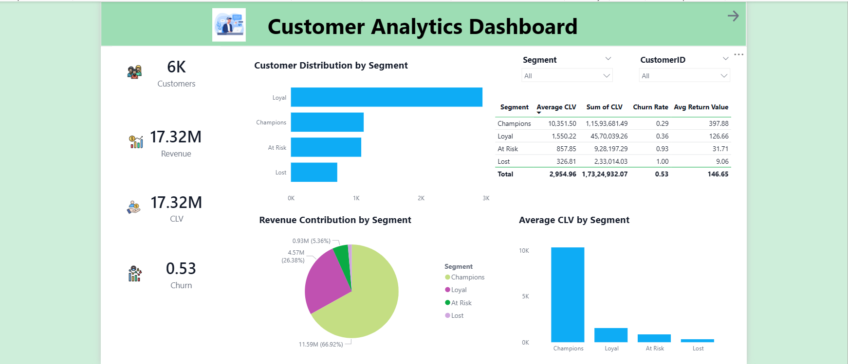

Slide 20
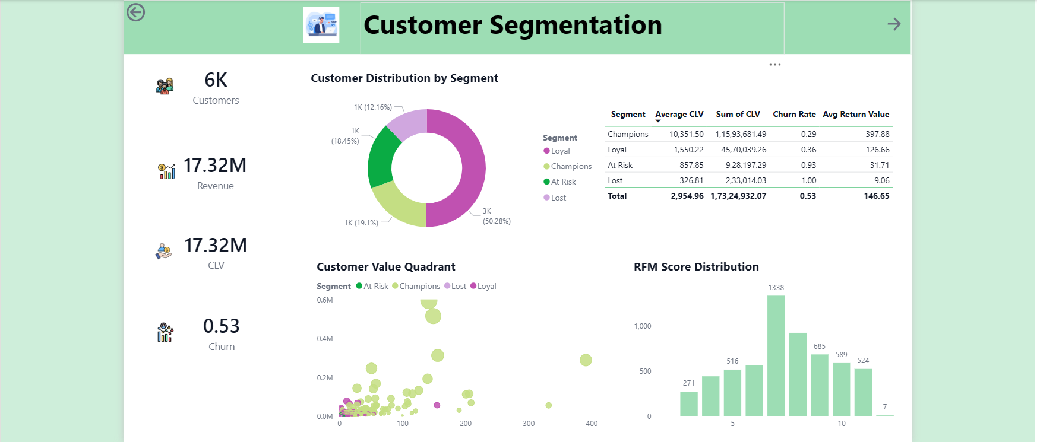

Slide 21
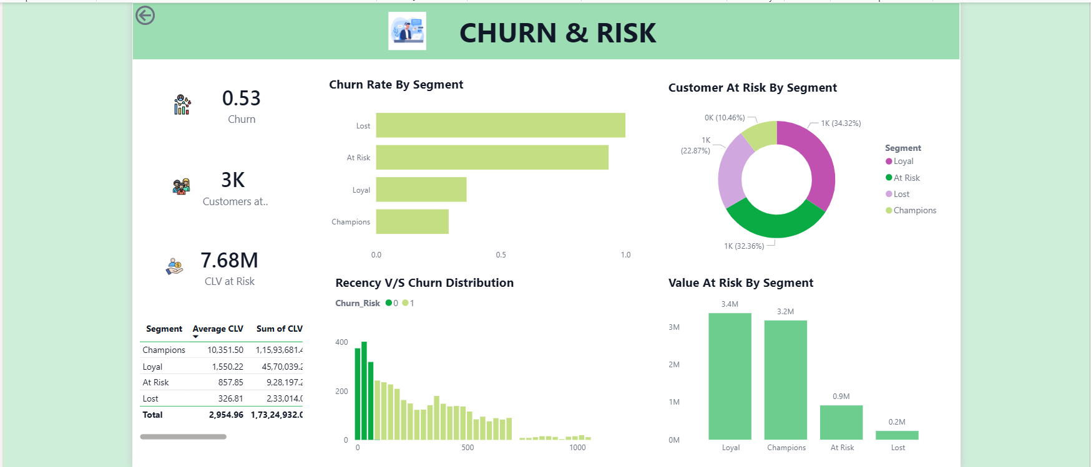

Slide 22
KEY INSIGHTS FROM THE DASHBOARD
Across all dashboard pages, several important insights emerged:
A small segment of customers contributes a large share of revenue.
High-value customers show clear behavioural patterns.
Churn risk increases significantly with prolonged inactivity.
Not all frequent customers are equally valuable.
These insights help the business focus its efforts where they matter most.

Slide 23
BUSINESS RECOMMENDATIONS
Based on the dashboard findings, the following actions are recommended:
Introduce targeted retention campaigns for high-CLV at-risk customers.
Reward and keep Champions through loyalty programs.
Re-engage inactive customers before they leave for good.
Shift from mass marketing to strategies based on specific segments.
These recommendations come directly from data, not assumptions.

Slide 24
CONCLUSION
By combining Excel, SQL, Python, and Power BI, this project:
Transformed raw transaction data into useful insights.
Enabled decision-making focused on customers. Showed complete analytical thinking.
The result is a practical, business-ready customer analytics solution.

